Slide 1
Business Solution Analyst Case Interview
October 2024

Slide 2

Sokovia Healthcare Network
Site #2
Site #3
Site #1
Site #4
Site #5

Slide 3

Hospital Ward Flow
Admissions
Separations
ED Admission Rate (%)
ED Visits
ED
Against Medical Advice Discharge
Inpatient Beds
Direct
Medical Discharge
Surgical
Death
ED Discharge

Slide 4
Assumptions on Data
Discharges is equivalent to Separations in the Inpatient Bed Count formula.
Funded Occupancy Rate is the percentage of inpatient beds that are funded.
The data covers a period from January 5, 2022 to September 30, 2024 (1000 days).

Slide 5
Data Source Design Overview
Reorganizing the Data
Adding a Date Column
Adding the Admissions Column
Handling Missing Values
Standardizing Site Names for Table Connections
Discrepancy in the ALC Table
Notes:
During the validation process, I identified a discrepancy in the ALC table. Specifically, I noticed that the Total ALC Count did not always match the sum of ALC Counts for Sites 1, 2, and 3. Initially, I assumed that the total might include Sites 4 and 5, but upon closer inspection, I discovered that the total was sometimes less than the sum for certain records.
Understanding the data collection process in more detail could help clarify this issue. There are a few possible explanations for the discrepancy: some data may have been excluded from the total due to missing information or failing to meet specific inclusion criteria. Another possibility is that some records were counted multiple times—perhaps a patient was assigned to more than one designation. Although the catalog states that patients are assigned to a single designation at a time, it also notes that this policy may change. Lastly, there could have been data entry errors.
Initially, I explored the possibility of estimating the total for these records by comparing the differences across designations. However, the discrepancies were present in multiple designations, not just Designation 1, but also in Designations 4, 5, and others.
Given that, I decided to treat the total and sum separately. For the analysis, I focus on the more detailed data from Sites 1, 2, and 3, since granular data provides more accurate insights and allows for a deeper understanding of the specific contributions from each site

Slide 6
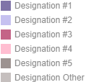
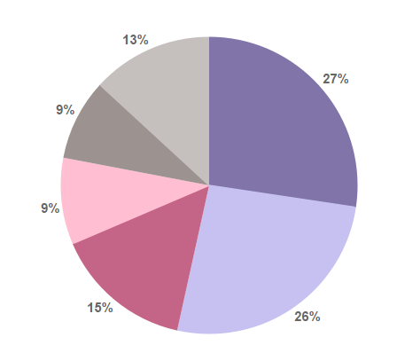
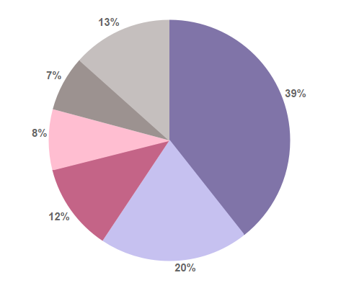
Discrepancy in ALC Count
Summation of
Sites #1, #2, and #3
TOTAL Count
Notes:
Given that, I decided to treat the total and sum separately. For the analysis, I focus on the more detailed data from Sites 1, 2, and 3, since granular data provides more accurate insights and allows for a deeper understanding of the specific contributions from each site

Slide 7
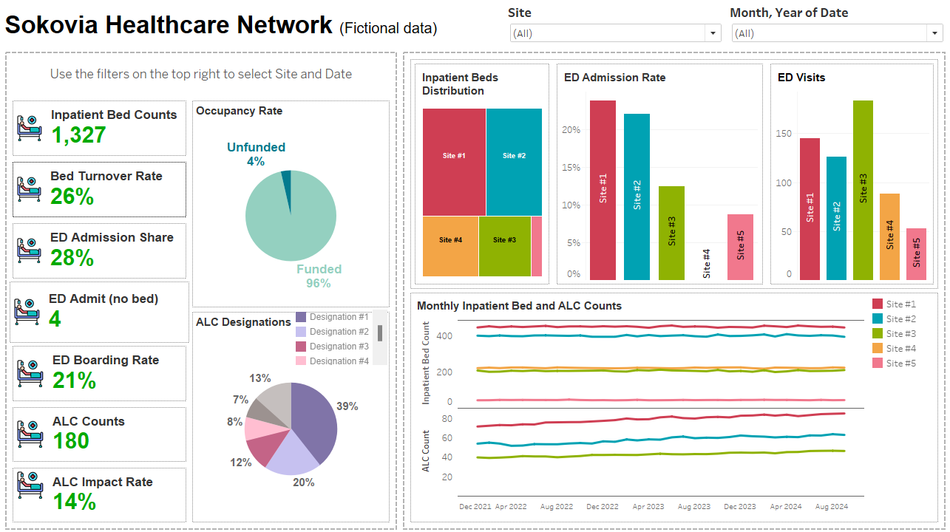
Tableau Dashboard Overview
(Link to dashboard)

Slide 8
Inpatient Bed Availability Barriers
High Occupancy Rates (Surgical Backlog)
Poor Bed Management
Slow Discharge Processes
Alternative Level of Care (ALC) Patients

Slide 9
Solutions for Inpatient Bed Availability
Expand Alternative Level of Care Resources
Cancel or Reschedule Elective Surgeries
Utilize Unfunded Beds Strategically

Slide 10
Thanks For Your Attention!

